Slide 1
Supergen Energy
Networks Hub
Dr Robin Preece
The University of Manchester

Slide 2
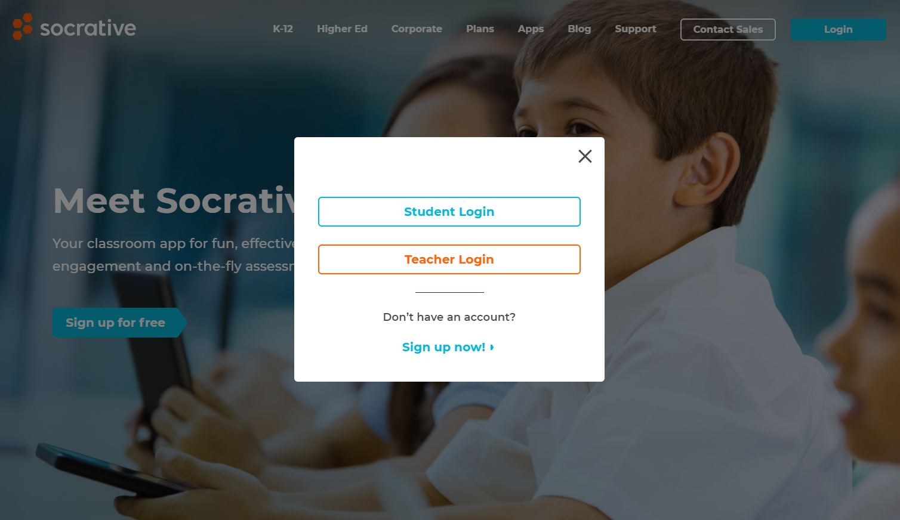
www.socrative.com

Slide 3
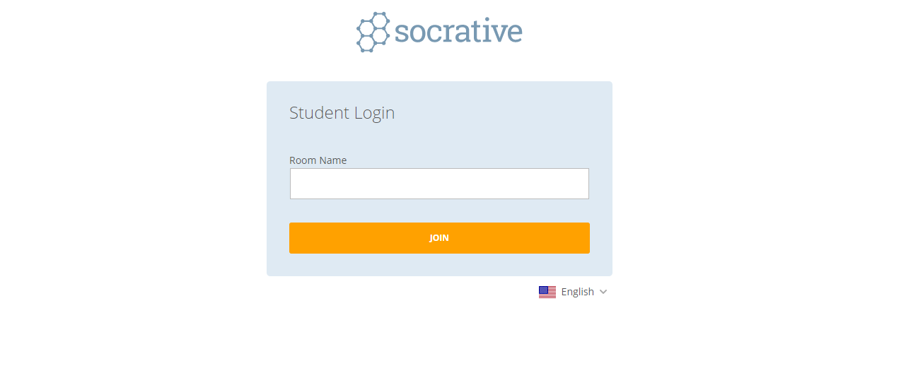
Room Name: DRPREECE
DRPREECE

Slide 4




What is the hub?

Slide 5




What can we do for ECRs?
Funding
Placements
Introductions
Committee

Slide 6

FUNDING
Flex-fund call (ECR ring-fenced)
Travel
Research visits
Placement support

Slide 7





PLACEMENTS
Linking ECRs to companies

Slide 8

INTRODUCTIONS
A conversation
Data
Models
Review
Real-world implications

Slide 9

COMMITTEE
Control over budget / initiatives / schemes / opportunities.
What you get:
  We cover travel costs for all meetings.
  £2500 for a conference while you are on the committee.

Slide 10

robin.preece@manchester.ac.uk
https://www.ncl.ac.uk/supergenenhub/ecrcommittee/
GET INVOLVED

